Slide 1
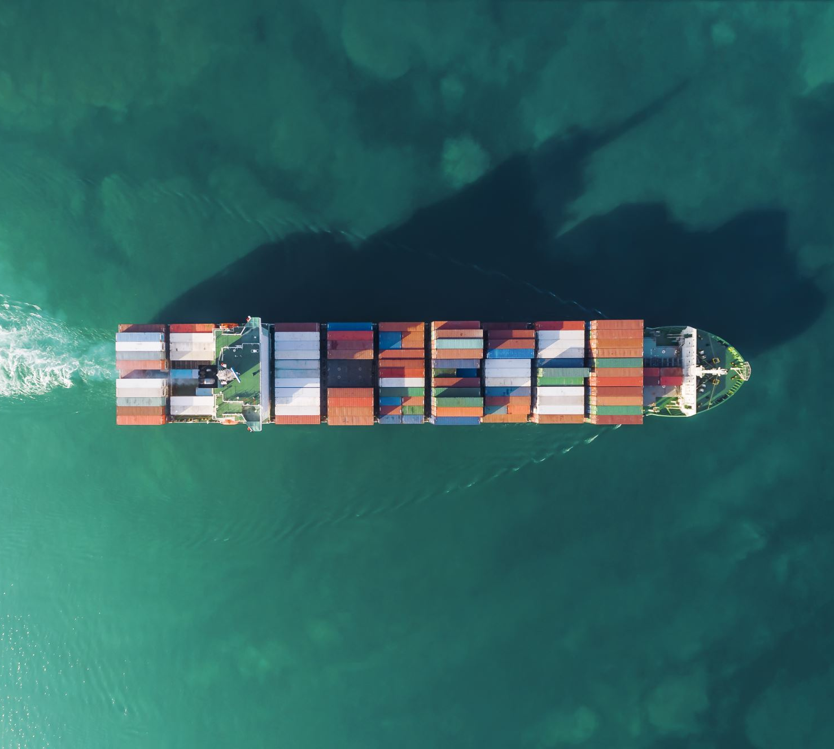
Analyzing Ocean Carrier Alliances
Transportation Research Group
School of Economic Sciences
College of Agriculture and Natural Resource Sciences
[WSU LOGO HERE]

Slide 2
What are Ocean Carrier Alliances (OCAs)?
Cooperative agreements between maritime freight carriers
Allies share capacity
e.g., Maersk will carry some cargo for Mediterranean and vice versa

Slide 3
A Brief History of Alliances
[alliance membership timeline]

Slide 4
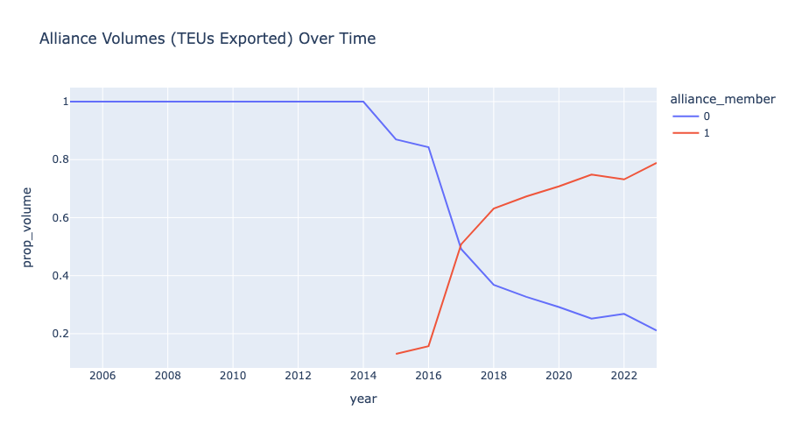

Slide 5
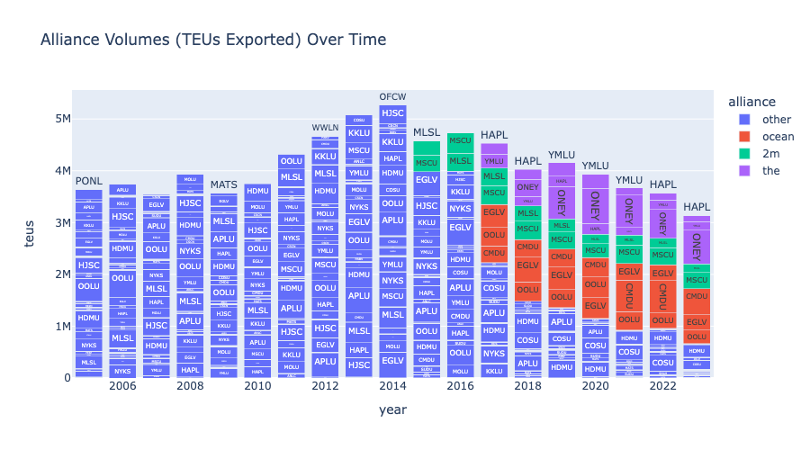

Slide 6
Antitrust Exemptions
Both US and EU have historically exempted carrier alliances from antitrust regulations
This tide may be changing
EU Consortia Block Exemption Regulation expired on 25 April 2024
US Congress is considering similar regulation changes
e.g. the Ocean Shipping Antitrust Enforcement Act

Slide 7
Impacts of OCAs on Domestic Producers
USDA Grant
Investigating impacts on US producers
Price
Quality of Service
Service Frequency

Slide 8
Measuring OCA Utilization
OCAs are not utilized on all lanes
Impacts of OCAs on a given lane should be proportional to utilization
i.e., the extent to which membership in an OCA causes a carrier to change its behavior
We are developing a metric for OCA utilization based on cargo sharing behavior

Slide 9
Cargo Sharing
We define a vessel’s ”Primary Carrier” as the carrier representing the most cargo carried on that vessel in any given month.
“Shared Cargo” is the cargo carried on a vessel not from the primary carrier.

Slide 10
Cargo Sharing through Time

